Slide 1

Electrical Machinery Fundamentals
EE 250 SPRING 2019
Lecture 1
1

Slide 2
Discipline: B.Sc. Electrical Engineering Semester: 4th Grading System: GPA Quiz: 20 Mid-term: 30 Final-term: 40 Assignments + Attendance: 10 Suggested Text: Electrical Machines, Drives and Power Systems by Theodore Wildi Reference Texts: Electric Machinery by AE Fitzgerald Contact Hours: Mon 10-12 Wed 9-12
EE 350 ELECTRIC MACHINERY FUNDAMENTALS

Slide 3
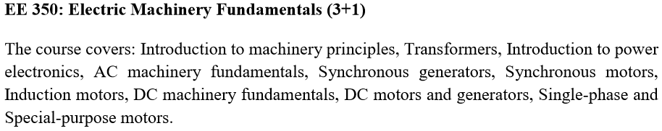
EE 350 ELECTRIC MACHINERY FUNDAMENTALS

Slide 4
Chapter 2 Fundamentals of Electricity, Magnetism and Circuits

Slide 5
2.1 Conventional and Electron Current Flow
Potential Difference

Slide 6
2.2 Distinction between sources and loads
Source : Delivers electrical power
Load : Absorbs electrical power
Current flows out of positive terminal
Current flows into positive terminal
What if polarity reveses for both boxes?

Slide 7
2.2 Distinction between sources and loads
Source : Delivers electrical power
Load : Absorbs electrical power
Resistor is source or load?
Solar cell
Battery?
Capacitor?

Slide 8
2.3 Sign Notation
Arithmetic : Addition and Subtraction
Machines: Direction of current ,mechanical force , rotational speed.
+400 rpm → -100 rpm

Slide 9
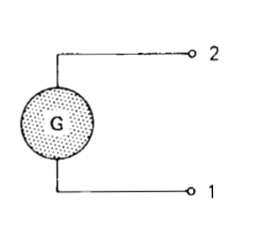
2.4 Double-subscript notation for voltages
E_{AB}=+100V
E_{BA}=-100V
E₂₁=-100V

Slide 10
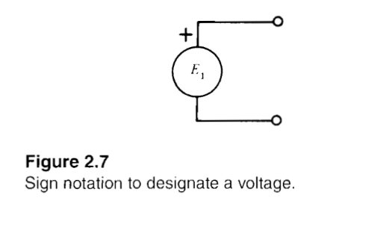
2.5 Sign notation for voltages
Designated as E_{1,}E₂ etc.
E₁=+100V
E₁=-100V

Slide 11
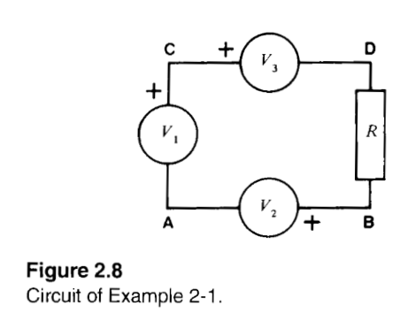
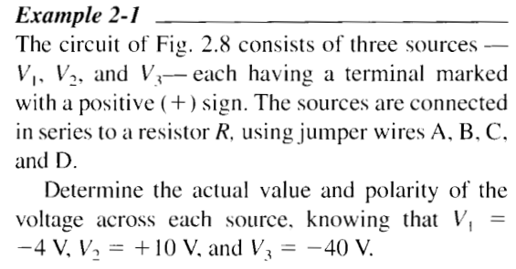
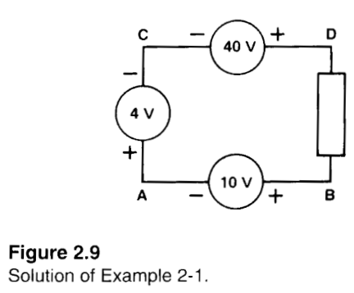
2.5 Sign notation for voltages

Slide 12
2.6 Graph of an alternating voltage
Alternating voltage→ polarity reversal
Generator source
Voltages changes polarity periodically
E(0.5)₂₁=+100V
E(1.5)₂₁=-100V
E(2.17)₂₁=+50V

Slide 13
2.7 Positive and negative currents
To indicate the direction of current flow
Either way flow
Arbitrarily sign allocation
X=Positive

Slide 14
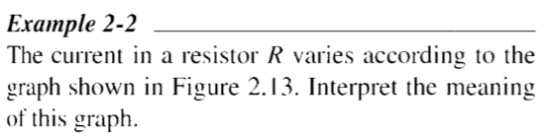
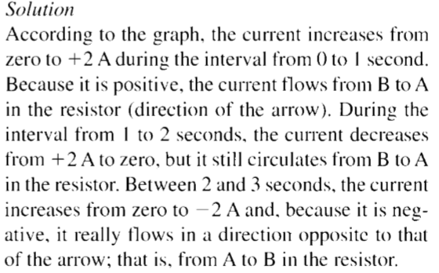
2.7 Positive and negative currents

Slide 15
2.8 Sinusoidal voltage
Nearly perfect sine wave of voltage by commercial alternators/generators.
Radians
Degrees

Slide 16
2.9 Converting cosine functions into sine functions
Cosine to sine (for both voltage and current)
Sine to cosine (for both voltage and current)

Slide 17
2.10 Effective value of an AC voltage
Properties of ac voltage are known when followings are specified:
Frequency
Peak value E_{m}
Common to use effective(RMS) value
Instruments are calibrated to show effective/RMS value
Average value of AC Signal?

Slide 18
2.11 Phasor representation of voltages and currents
Mostly Frequency is fixed in power studies
No Concern
Instantaneous voltages & currents
Concern
RMS (effective) magnitudes
Phase angles
A phasor is similar to a vector, its length is proportional to RMS/Effective value of voltage or current it represents.
The angle between two phasors is equal to electrical phase angle between two quantities.

Slide 19
In phase if:
Parallel
Same direction
Zero phase angle
Out of phase if:
Different direction

Slide 20
3. E leads I if :
Lead (E rotated clockwise)
Lag (E rotated counterclockwise)
4. I leads E if :
Lead (I rotated clockwise)
Lag (I rotated counterclockwise)
5. Phasor may not have common start point
I₂ leads E₂ by 135°
E₂ lags I₂ by 135°

Slide 21
2.12 Harmonics
Mostly voltages and currents are not pure sine waves in power circuits
Voltage usually have satisfactory wave shape
Currents are sometime badly distorted
Distortion can be produced by:
Magnetic Saturation in cores of transformers
Switching action of thyristors

Slide 22
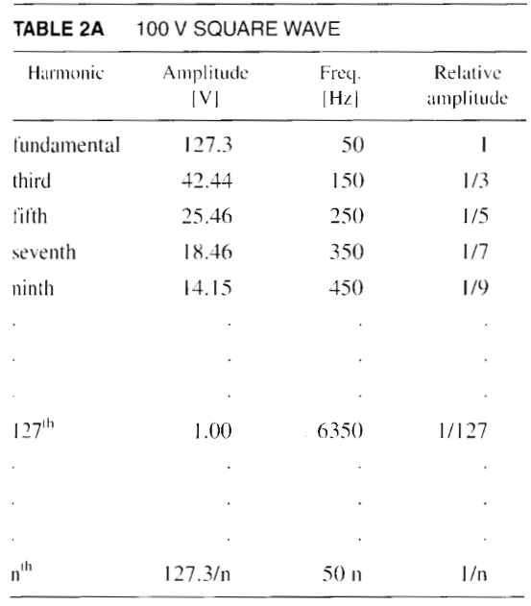
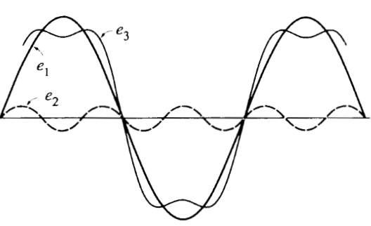
2.12 Harmonics
Harmonics is any voltage or current whose frequency is and integral multiple of line frequency.

Slide 23
2.13 Energy in an inductor
Coil(inductor) stores energy in magnetic field
Stored Energy Depends upon current

Slide 24
2.14 Energy in a capacitor
Capacitor stores energy in electrical field
Stored Energy Depends upon voltage

Slide 25
2.15 Some useful equations
Required for solving ac circuits

Slide 26
2.16 Magnetic field intensity H and flux density B
Magnetic flux φ (number of magnetic field lines passing through a closed surface) in a body is due to magnetic field strength H

Slide 27
2.17 B-H curve of vacuum
B and H are directly proportional in vacuum

Slide 28
2.18 B-H curve of magnetic material
Here releative permeability of material varies with material

Slide 29

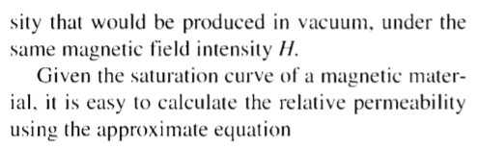
2.19 Determination of relative permeability

Slide 30
2.20 Faraday’s law of electromagnetic induction
If flux varies w.r.t T in a loop, voltage is introduced.
Induced voltage is in direct proportion with rate change of flux.

Slide 31
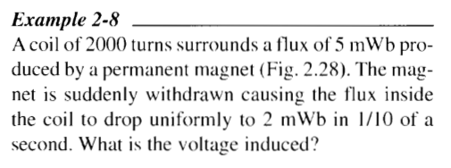

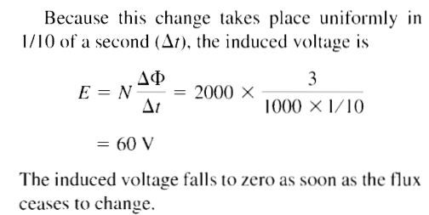
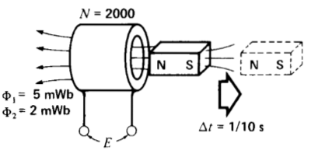
2.20 Faraday’s law of electromagnetic induction

Slide 32
2.21 Voltage induced in a conductor
Coil moves w.r.t fixed flux
Relative motion results change in flux that induces voltage in coil
When a conductor cuts magnetic field , voltage is induced across its terminals

Slide 33
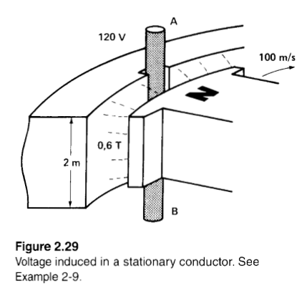
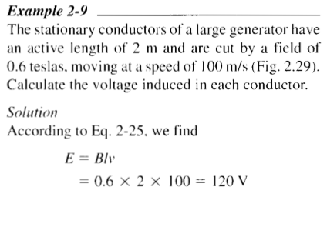
2.21 Voltage induced in a conductor

Slide 34
2.22 Lorentz force on a conductor
Current-carrying conductor in magnetic field experiences a force known as electromagnetic force or Lorentz force.
Magnitude of force depends upon:
Orientation of conductor
Direction of field
Maximum force when conductor is perpendicular w.r.t field and minimum when parallel
Sinθ

Slide 35
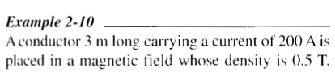
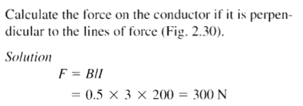
2.22 Lorentz force on a conductor
Sinθ

Slide 36
2.23 Direction of force acting on a straight conductor
Current CARRYING conductor is surrounded by a magnetic field.
Current flowing into the board will have circular lines of force in the direction shown in figure:
Two different fields.
Line of forces are:
In same direction above the conductor.
In opposite direction below the conductor.
No. of lines above the conductor > No. of lines below the conductor

Slide 37
2.24 Residual flux density and coercive force
Increasing current will:
Increase H and B
Bm, maximum flux
Upon reducing current:
Flux density will not follow the original path.
Magnetic domains that were lined up under the influence of H_{m} tend to retain their original orientation. (Called hysteresis)
Residual Flux Br
Magnetic field strength H_{c} required to reduce flux density from b to c is called coercive force.

Slide 38
2.25 Hysteresis Loop
Transformers, electric motors operates on AC.
In these devices flux changes both in direction and value.
Magnetic domains changes the direction of orientation.
Frequency 60 Hz => T=1/60 s

Slide 39

2.26 Hysteresis Loss
To describe hysteresis loop , the flux moves through +B_{m} ,+B_{r} ,0,-B_{m} ,-B_{r} ,0 and +B_{m}
Magnetic material absorbs energy during each cycle and this energy is dissipated as heat
Amount of heat released per cycle = Area of hysteresis loop

Slide 40
2.27 Hysteresis losses caused by rotation
Hysteresis losses are caused by the rotation of iron piece in a constant magnetic field.

Slide 41
2.28 Eddy currents
Eddy current=Circular current or swirling current
Produced as a result of placing conductor in changing magnetic field
Induced voltage, current and dissipated power depends upon flux linkage that depends upon size of loop.
Solid plate equivalent to densely packed set of rectangular loop coils touching each other.
Eddy currents can be large due to low resistance of plate. (I²R losses)
Metal plate can become very hot.

Slide 42
2.29 Eddy currents in a stationary iron core
Large core can become red hot due to eddy current losses
Losses can be reduced by splitting iron core along its length
Thin laminations (insulator b/w two cores)
Half voltage induction in one of two parts as that of original iron core

Slide 43
2.30 Eddy-current losses in a revolving core
Stationary field in DC motors and generators produces constant DC flux
Constant flux induces eddy current in revolving armature
Armature is of low resistance => Large eddy currents => Large I²R losses => Large heat
To reduce eddy current=> Laminations b/w divided core

Slide 44
2.32 Kirchhoff’s voltage law
Algebraic sum of voltages around a closed loop is zero
In a closed circuit=> Sum of voltage rises=Sum of voltage drops
We will begin with double-subscript notation followed by sign notation

Slide 45
2.33 Kirchhoff’s voltage law and double-subscript notation
Starting with node 2 and moving cw around loop ABCD, KVL equation is as follows:

Slide 46
2.34 Kirchhoff’s current law

Slide 47
2.35 Currents, Impedances and associated voltages
Moving across Z in the same direction as that of current=>the associated polarity is positive and vise versa
Z can be resistive, inductive or capacitive
In loop 2312 starting with node 2 and moving CW :

Slide 48
Summary
2.1-2.35
Excluding 2.31
Assignment: Example 2.1-2.10

